Slide 1
CSI2005 Principles of Compiler Design
MODULE - 6
Dr. WI. Sureshkumar
Associate Professor
School of Computer Science and Engineering (SCOPE)
VIT Vellore
wi.sureshkumar@vit.ac.in
SJT413A34

Slide 2
Code Optimization
Basic Blocks and Flow Graphs
The DAG Representation of Basic Blocks
The Principal Sources of Optimization
Optimization of Basic Blocks
Loops in Flow Graphs
Peephole Optimization
Introduction to Global Data-Flow Analysis

Slide 3
Code Optimization
Optimization is a program transformation technique, which tries to improve the code by making it consume less resources (i.e. CPU, Memory) and deliver high speed.
In optimization, high-level general programming constructs are replaced by very efficient low-level code
Advantages
Faster execution
Efficient memory usage
Better performance

Slide 4
Code Optimization Techniques
Compile time evaluation
Constant folding
Constant propagation
Common sub-expression elimination
Strength reduction
Code motion
Dead code elimination

Slide 5
Code Optimization Techniques
Constant folding
It refers to a technique if evaluating the expressions whose operands are known to be constant at compile time.
Ex. a = (22/ 7) * b;
Constant propagation
Constants assigned to a variable can be propagated through the flow graph and substituted at the use of the variable.
Ex. In the code fragment below, the value of x can be propagated to the use of x.
x = 3;
y = x + 4;
Below is the code fragment after constant propagation and constant folding.
x = 3;
y = 7;

Slide 6
Code Optimization Techniques
Strength reduction
Use the fastest version of an operation
E.g.
x >> 2 instead of x / 4
x << 1 instead of x * 2
Common sub expression elimination
Eliminate redundant calculations
E.g.
double x = d * (lim / max) * sx;
double y = d * (lim / max) * sy;
double depth = d * (lim / max);
double x = depth * sx;
double y = depth * sy;

Slide 7
Code Optimization Techniques
Common sub expression elimination
t1 = 4 * i t1 = 4 * i
t2 = a[t1] t2 = a[t1]
t3 = 4 * j t3 = 4 * j
t4 = 4 * i t5 = n
t5 = n t6 = b[t1] + t5
t6 = b[t4] + t5
Before Optimization After Optimization

Slide 8
Code Optimization Techniques
Code motion
Invariant expressions should be executed only once
E.g.
for (int i = 0; i < x.length; i++)
x[i] *= Math.PI * Math.cos(y);
double picosy = Math.PI * Math.cos(y);
for (int i = 0; i < x.length; i++)
x[i] *= picosy;

Slide 9
Code Optimization Techniques
Code that is unreachable or that does not affect the program (e.g. dead stores) can be eliminated.
Ex:
In the example below, the value assigned to i is never used, and the dead store can be eliminated. The first assignment to global is dead, and the third assignment to global is unreachable; both can be eliminated.
int global;
void f () Below is the code fragment after dead code elimination.
{ int global;
int i; i = 1; /* dead store */ void f ()
global = 1; /* dead store */ {
global = 2; global = 2;
return; return;
global = 3; /* unreachable */ }
}

Slide 10
Basic Blocks
A basic block is a maximal sequence of consecutive three-address instructions with the following properties:
The flow of control can only enter the basic block through the 1st instruction.
Control will leave the block without halting or branching, except possibly at the last instruction.
Basic blocks become the nodes of a flow graph, with edges indicating the order.

Slide 11
Examples
i = 1
j = 1
t1 = 10 * i
t2 = t1 + j
t3 = 8 * t2
t4 = t3 - 88
a[t4] = 0.0
j = j + 1
if j <= 10 goto (3)
i = i + 1
if i <= 10 goto (2)
i = 1
t5 = i - 1
t6 = 88 * t5
a[t6] = 1.0
i = i + 1
if i <= 10 goto (13)
for i from 1 to 10 do
for j from 1 to 10 do
a[i,j]=0.0
for i from 1 to 10 do
a[i,i]=1.0

Slide 12
Identifying Basic Blocks
Input: sequence of instructions instr(i)
Output: A list of basic blocks
Method:
Identify leaders: the first instruction of a basic block
Iterate: add subsequent instructions to basic block until we reach another leader

Slide 13
Identifying Leaders
Rules for finding leaders in code
First instruction in the code is a leader
Any instruction that is the target of a (conditional or unconditional) jump is a leader
Any instruction that immediately follow a (conditional or unconditional) jump is a leader

Slide 14
Basic Block Example
i = 1
j = 1
t1 = 10 * i
t2 = t1 + j
t3 = 8 * t2
t4 = t3 - 88
a[t4] = 0.0
j = j + 1
if j <= 10 goto (3)
i = i + 1
if i <= 10 goto (2)
i = 1
t5 = i - 1
t6 = 88 * t5
a[t6] = 1.0
i = i + 1
if i <= 10 goto (13)
A
B
Leaders
C
Basic Blocks
D
E
F

Slide 15
Control-Flow Graphs
Control-flow graph:
Node: an instruction or sequence of instructions (a basic block)
Two instructions i, j in same basic block iff execution of i guarantees execution of j
Directed edge: potential flow of control
Distinguished start node Entry & Exit
First & last instruction in program

Slide 16
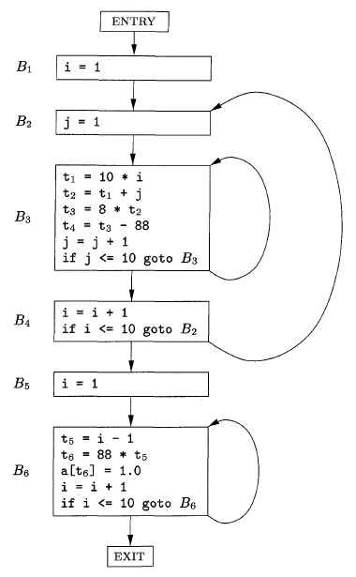
CFG Example

Slide 17
Loop Examples
{B3}
{B6}
{B2, B3, B4}

Slide 18
Peephole Optimization
Introduction to peephole
Common techniques
Algebraic identities
An example

Slide 19
Peephole Optimization
Simple compiler do not perform machine-independent code improvement
They generates naive code
It is possible to take the target hole and optimize it
Sub-optimal sequences of instructions that match an optimization pattern are transformed into optimal sequences of instructions
This technique is known as peephole optimization
Peephole optimization usually works by sliding a window of several instructions (a peephole)

Slide 20
Peephole Optimization
Goals:
- improve performance
- reduce memory footprint
- reduce code size
Method:
1. Exam short sequences of target instructions
2. Replacing the sequence by a more efficient one.
redundant-instruction elimination
algebraic simplifications
flow-of-control optimizations
use of machine idioms

Slide 21
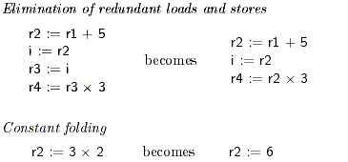
Peephole Optimization Common Techniques

Slide 22
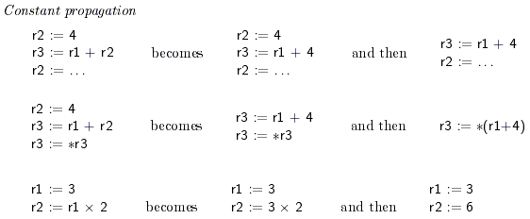
Peephole Optimization Common Techniques

Slide 23
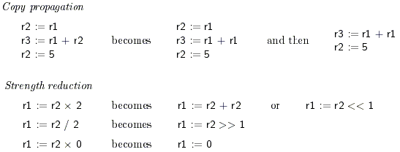
Peephole Optimization Common Techniques

Slide 24

Peephole Optimization Common Techniques

Slide 25
Algebraic identities
Worth recognizing single instructions with a constant operand
Eliminate computations
A * 1 = A
A * 0 = 0
A / 1 = A
Reduce strength
A * 2 = A + A
A/2 = A * 0.5
Constant folding
2 * 3.14 = 6.28
More delicate with floating-point

Slide 26
Replace Multiply by Shift
A := A * 4;
Can be replaced by 2-bit left shift (signed/unsigned)
But must worry about overflow if language does
A := A / 4;
If unsigned, can replace with shift right
But shift right arithmetic is a well-known problem
Language may allow it anyway (traditional C)

Slide 27
Addition chains for multiplication
If multiply is very slow (or on a machine with no multiply instruction like the original SPARC), decomposing a constant operand into sum of powers of two can be effective:
X * 125 = x * 128 - x*4 + x
two shifts, one subtract and one add, which may be faster than one multiply
Note similarity with efficient exponentiation method

Slide 28
Flow-of-control optimizations
goto L1
. . .
L1: goto L2
goto L2
. . .
L1: goto L2
if a < b goto L1
. . .
L1: goto L2
if a < b goto L2
. . .
L1: goto L2
goto L1
. . .
L1: if a < b goto L2
L3:
if a < b goto L2
goto L3
. . .
L3:

Slide 29
Peephole Opt: an Example
debug = 0
. . .
if(debug) {
print debugging information
}
Source Code:
debug = 0
. . .
if debug = 1 goto L1
goto L2
L1: print debugging information
L2:
Intermediate
Code:

Slide 30
Eliminate Jump after Jump
debug = 0
. . .
if debug = 1 goto L1
goto L2
L1: print debugging information
L2:
Before:
debug = 0
. . .
if debug ≠ 1 goto L2
print debugging information
L2:
After:

Slide 31
Constant Propagation
debug = 0
. . .
if debug ≠ 1 goto L2
print debugging information
L2:
Before:
debug = 0
. . .
if 0 ≠ 1 goto L2
print debugging information
L2:
After:

Slide 32
Peephole Optimization Summary
Peephole optimization is very fast
Small overhead per instruction since they use a small, fixed-size window
It is often easier to generate naïve code and run peephole optimization than generating good code.

Slide 33
Loops in Flow Graphs
Dominators:
- A node d of a flow graph dominates node n ( a node d is a dominator of a node n), written d dom n, if
- Every path from the initial node of the flow graph to node n
goes through d
- Every node dominates itself
- Entry node of a loop dominates all node in the loop.
A useful way of presenting dominator information is in a tree, called a dominator tree.
- Initial node is a root
- Each node dominates only its descendants in the tree

Slide 34
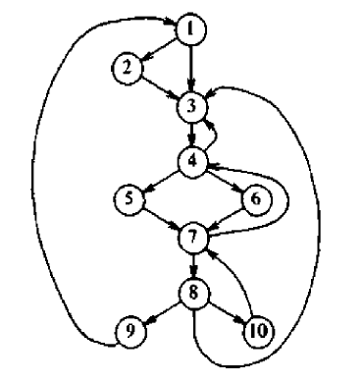
Example:
1 dominates = { 1, 2, 3, 4, 5, 6, 7, 8, 9, 10} }
2 dominates = { 2 }
3 dominates = { 3, 4, 5, 6, 7, 8, 9, 10}
4 dominates = { 4, 5, 6, 7, 8, 9, 10}
5 dominates = { 5 }
6 dominates = { 6}
7 dominates = { 7, 8, 9, 10}
8 dominates = { 8, 9, 10}
9 dominates = { 9 }
10 dominates = {10}

Slide 35
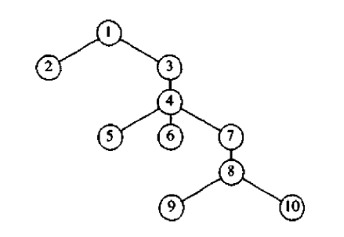
Dominator tree:

Slide 36
Natural Loops
One important application of dominator information is in determining the loops of a flow graph suitable for improvement. There are two essential properties of such loops:
1. A loop must have a single entry point, called the header. This entry
point dominates all nodes in the loop.
2. There must be at least one way to iterate the loop i.e. at least one
path back to the header.

Slide 37
A good way to find all the loops in a flow graph is to search for the edges whose heads dominate their tails.
If a→b is an edge, b is the head and a is the tail. We call such edges are back edges.
There is a edge 7→4, and 4 dom 7
There is a edge 4→3, and 3 dom 4
There is a edge 10→7, and 7 dom 10
There is a edge 8→3, and 3 dom 8
There is a edge 9→1, and 1 dom 9

Slide 38
- Given a back edge n→d, we define the natural loop of the edge
to be d plus the set of nodes that can reach n without going
through d.
- Node d is the header of the loop
The natural loop of the edge 10→7 consists of the nodes
7, 8 and 10
The natural loop of the edge 9→1 is the entire flow grah.

Slide 39
Example:
Consider the following program fragment:
Fact(x)
{
int f = 1;
for(i=2; i<=x; i++)
f = f * I;
return(f);
}

Slide 40
The three address –code representation of the program fragment is:
10 f = 1 Leaders are 10
11 i =2 12, 14, 18
If i <= x goto 14 13
goto 18 B1: 10, 11
f = f * i B2: 12
t1 = i + 1 B3: 13
i = t1 B4: 14, 15, 16, 17
goto 12 B5: 18
goto calling program

Slide 41
B1
B2
B3
B4
B5

Slide 42
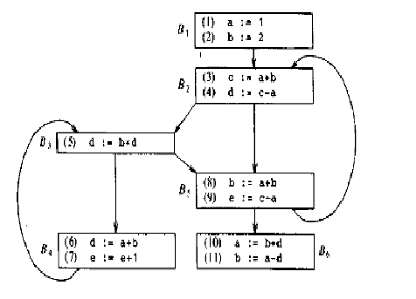
Find dominators and natural loops in the following flow graph:

